Slide 1

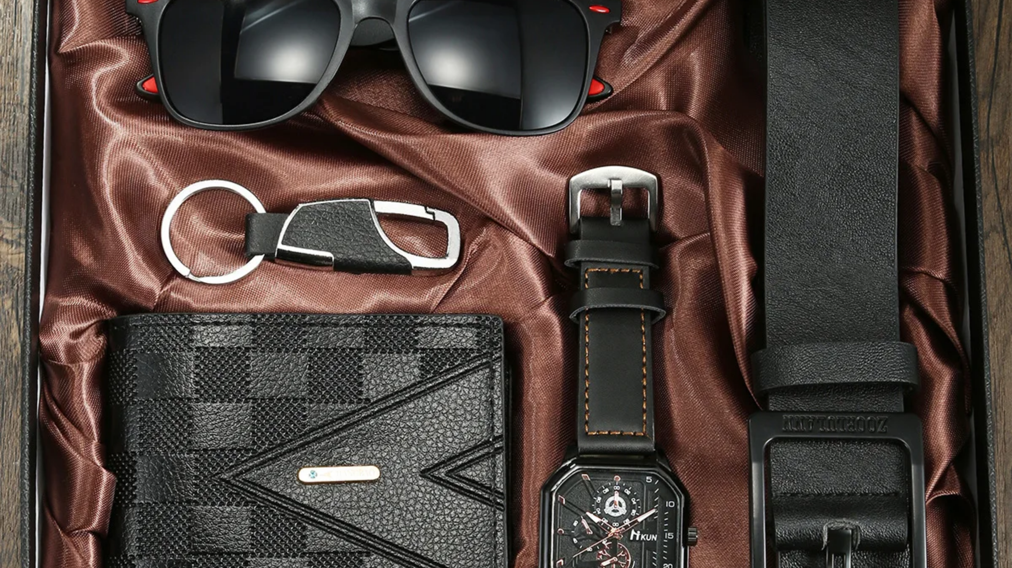


VELVORÉ
Luxury E-Commerce Platform
Premium Watches
Sunglasses
Leather Wallets
•
•

Slide 2


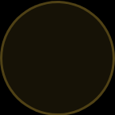



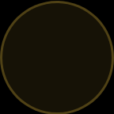




Abstract
VELVORÉ is a premium luxury e-commerce platform specializing in watches, sunglasses, and leather wallets. Built to deliver an exceptional online shopping experience, VELVORÉ combines sophisticated design with functional e-commerce features.
Technology Stack
Luxury UI/UX
Built with HTML, CSS, JavaScript, and LocalStorage for a robust frontend experience.
Designed with premium aesthetics and user experience in mind.
Modern Features
Purpose
Responsive layout with product pages, cart, and wishlist functionality.
To demonstrate frontend development skills and create a premium shopping interface.
VELVORÉ represents the convergence of luxury branding and modern e-commerce technology, delivering a sophisticated shopping experience through clean design and intuitive functionality.
2/10

Slide 3














System Overview & Workflow
User
Home
Categories
Product Page
Cart/Wishlist
Checkout
Navigation Structure
Product Display Logic
Intuitive navigation with category filtering and search functionality for seamless browsing experience.
Dynamic product listing with premium visuals and detailed specifications for each category.
LocalStorage Integration
Interactive UI Elements
Persistent cart and wishlist management using browser LocalStorage for data retention.
Hover effects, animations, and responsive elements enhancing user engagement.
3/10

Slide 4

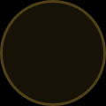
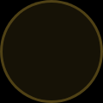




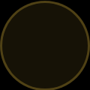
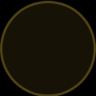



Literature Survey
Research analysis of premium brands and luxury e-commerce principles
Premium Brands Analysis
Luxury UI Patterns
Fossil: Modern luxury timepieces with digital integration
Minimalist design with ample white space
Louis Vuitton: Heritage-driven premium branding
Subtle animations and transitions
Titan: Premium watches with traditional craftsmanship
Premium typography and hierarchy
Ray-Ban: Iconic sunglasses with timeless design
Gold accent elements for visual contrast
Color Psychology
E-commerce Best Practices
Black: Sophistication, elegance, timelessness
Product card design with hover effects
Gold: Luxury, premium quality, exclusivity
Category-based product browsing
White space: Cleanliness, simplicity
Responsive design for all devices
Intuitive navigation and user flow
4/10

Slide 5

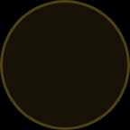
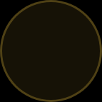


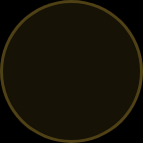
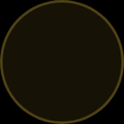



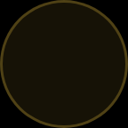
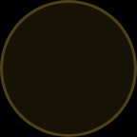


Project Objectives
VELVORÉ aims to create a premium luxury e-commerce experience through strategic development goals:
High-End Interface
Category Browsing
Build a premium shopping interface that embodies luxury aesthetics.
Implement intuitive category-based product navigation.
Premium Display
Shopping Systems
Showcase products with luxury design standards and details.
Implement cart and wishlist functionality with LocalStorage.
Responsive Design
Brand Consistency
Ensure seamless experience across all devices.
Maintain unified brand identity throughout the platform.
Each objective contributes to VELVORÉ's core mission of delivering a luxurious shopping experience.
5/10

Slide 6



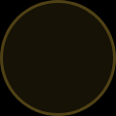
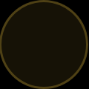
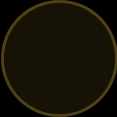






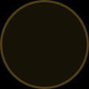
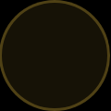
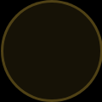



Development Methodology
Planning
Design
Development
• Theme selection
• Wireframes
• HTML structure
• Product categories
• Layout
• CSS styling
• Feature prioritization
• Hero banner design
• JavaScript functionality
• Color palette
Integration
Testing
Deployment
• LocalStorage cart
• UI testing
• Vercel hosting
• Wishlist functionality
• Responsiveness
• Index routing
• Data persistence
• Functionality
• Folder optimization
6/10

Slide 7









Development Details
Multi-page Architecture
Interactive UI Elements
Home, Products, About, Cart, and Wishlist pages with seamless navigation.
Add-to-Cart and Wishlist functionality with visual feedback.
Premium Visual Elements
Product Arrays in JavaScript
Animations and hover effects enhancing user experience.
Organized product data structures for watches, sunglasses, and wallets.
Optimized Folder Structure
Dynamic Product Listing
/css/
├── style.css
/js/
JavaScript-generated product displays with category filtering.
├── main.js
└── products.js
// Add to Cart Function function addToCart(productId) { localStorage.setItem('cart', newCart); this.updateCartDisplay(); }
7/10

Slide 8



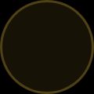


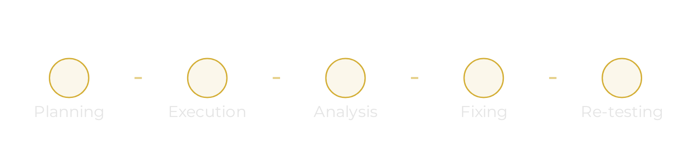
Testing & Quality Assurance
Functional Testing
Bug Fixes & Refinement
Comprehensive validation of cart and wishlist systems, ensuring seamless user interactions and data persistence.
Systematic resolution of issues including broken links, overflow problems, and missing media elements.
UI Testing
meticulous checks of spacing, alignment, and responsiveness across different screen sizes to maintain luxury aesthetics.
Cross-Device Testing
Verification of platform performance on mobile, tablet, and desktop devices to ensure consistent experience.
Testing Workflow
VELVORÉ underwent iterative refinement based on testing feedback, ensuring a polished final product that meets luxury standards.
Quality assurance is integral to VELVORÉ's development, ensuring an experience that matches its luxury positioning.
8/10

Slide 9
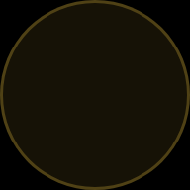
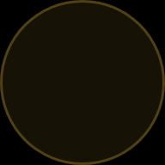
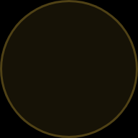
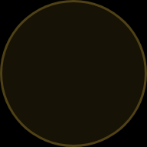




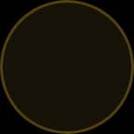
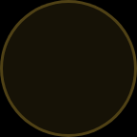


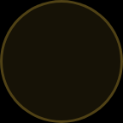
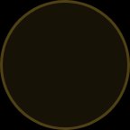


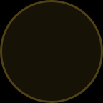


Deployment & Hosting
Development
Build
Deploy
Live
Vercel Deployment
Folder Optimization
VELVORÉ is deployed on Vercel for optimal performance and global availability. The platform provides automatic HTTPS and custom domain support.
The project structure is optimized for deployment with separate directories for HTML, CSS, and JavaScript files.
Index Routing Considerations
Static Hosting Configuration
Custom routing rules ensure proper navigation between product categories and pages.
The e-commerce platform is configured as a static site with optimized assets for fast loading times and smooth user experience.
Vercel Advantages
GitHub Integration
Global CDN for fast content delivery
Version updates are managed through GitHub, enabling seamless deployments and maintaining project history.
Automatic SSL certificates
Custom domain support
9/10

Slide 10

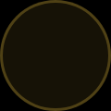











Conclusion & Future Scope
Premium Experience
Technical Skills
Achieved a luxurious e-commerce experience with responsive design.
Demonstrated frontend development expertise with HTML/CSS/JS.
Professional Branding
Scalability
Created clean UI with consistent brand identity.
Built foundation for future upgrades.
Future Enhancements
Database Integration
Login System
Payment Gateways
Progressive Web App
Thank you for your consideration
10/10

Slide 11
Thank You
Developed By:
Mayur S 24SUUBECS1169
Mayur S 24SUUBECS1168
Manvanth M 24SUUBECS1151
Manvith 24SUUBECS1152
10/10

